Slide 1




RISC-V Integrated With Cache System From Architecture to GDS II (Simulations Part)
Designed and implemented by:
Hammed Omar
Mohamed Adel
Youssef Ahmed

Slide 2

RISC-V
RISC-V architecture and instructions set
Integration RISC-V With Cache
Integration RISC-V with cache to make the SOC
Simulation Results
Check the functionality of the integrated system
Agenda

Slide 3

1
RISC-V Architecture

Slide 4


RISC-V is an open-source, modular instruction set architecture that supports a base set of instructions and optional extensions. Its flexibility and scalability make it suitable for diverse applications.

Slide 5
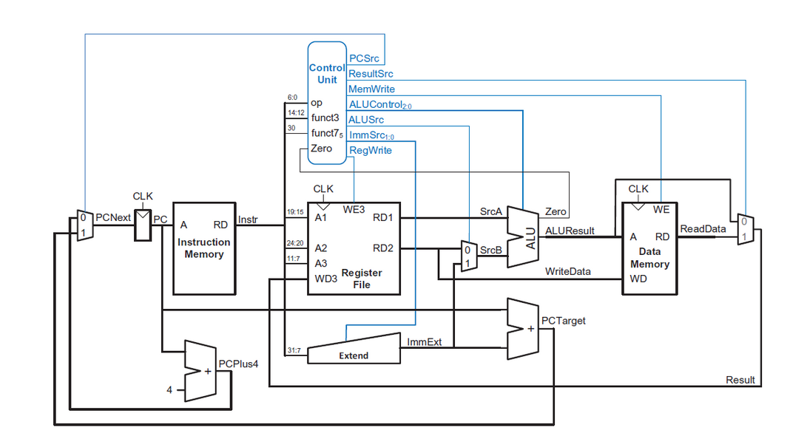

RISC-V Simple Architecture

Slide 6
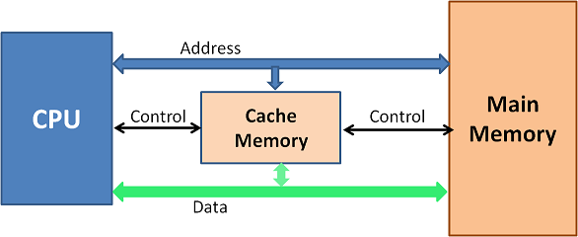
RISC-V and Cache Memory

Slide 7
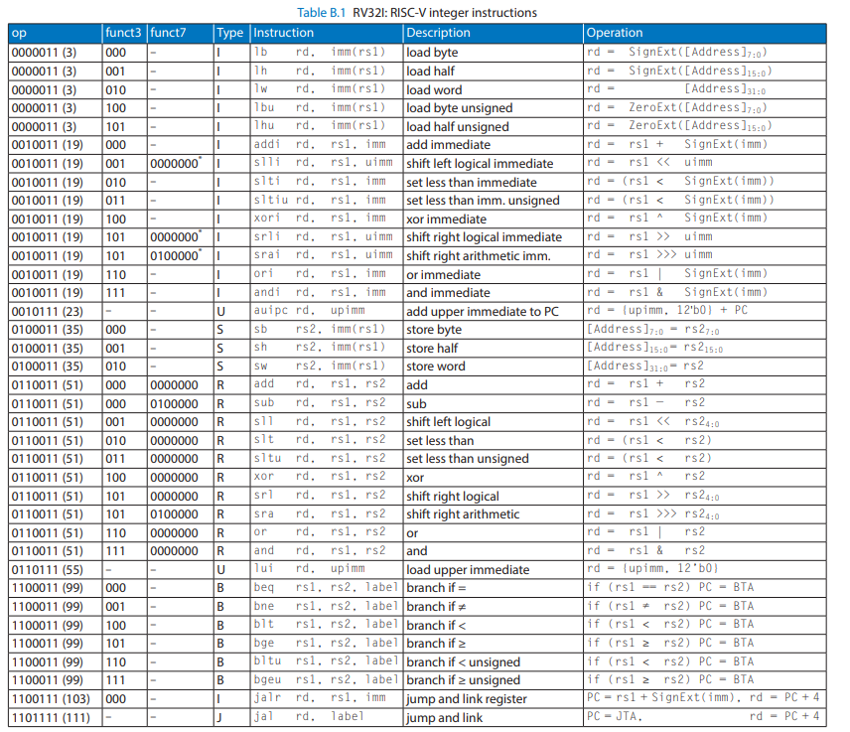
RV32I Instructions Set

Slide 8
Integration RISC-V With Cache To Make The SOC
2

Slide 9
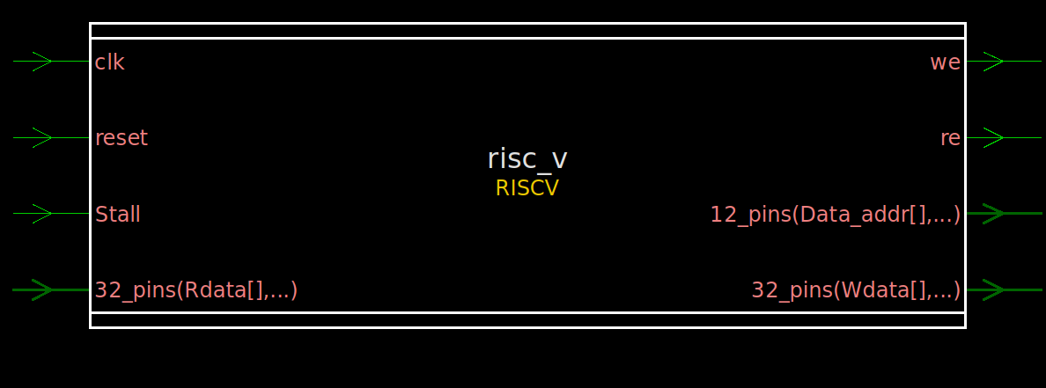
RISC-V

Slide 10
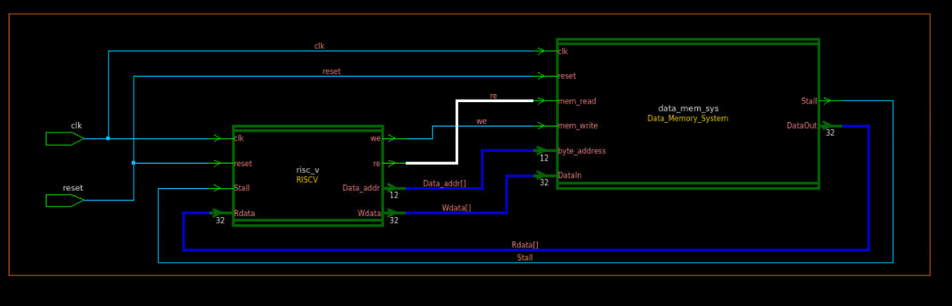
Top Level Design

Slide 11
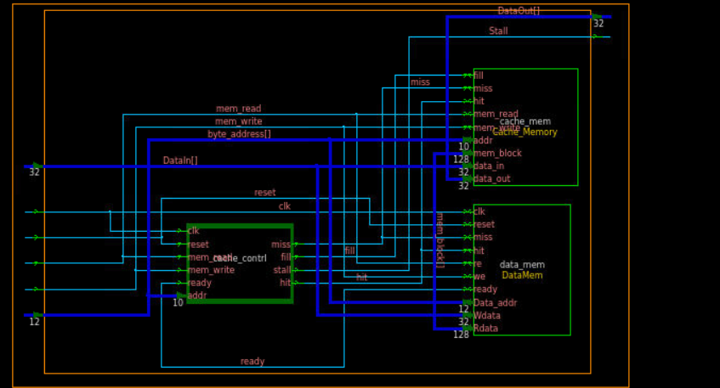
Data Memory System

Slide 12


FSM of Cache Controller
we = re
Reset
we = 1 && re =0
d
IDLE
we = 1 && re =0
d
Writing
we = 0&& re =1
we = 1 && re =0
we = 0&& re =1
we = re
d
Reading
we = 0&& re =1

Slide 13
3
Simulation Results

Slide 14
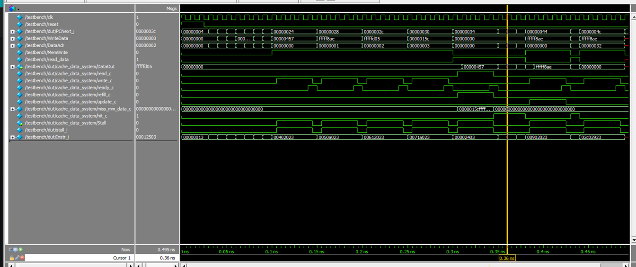
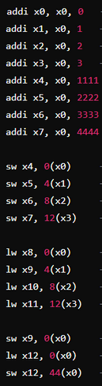
Program 0

Slide 15
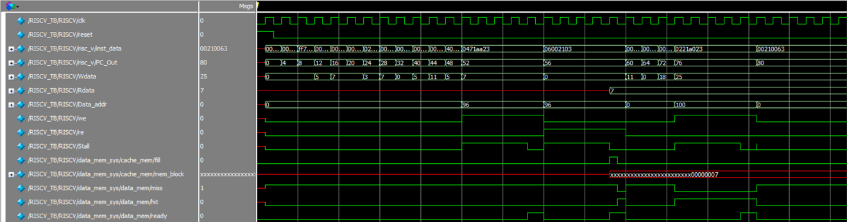
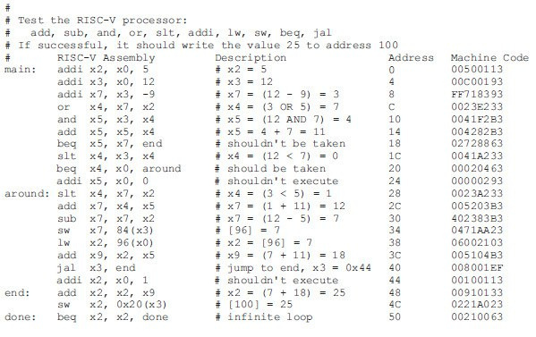
Program 1
infinity loop
occured

Slide 16
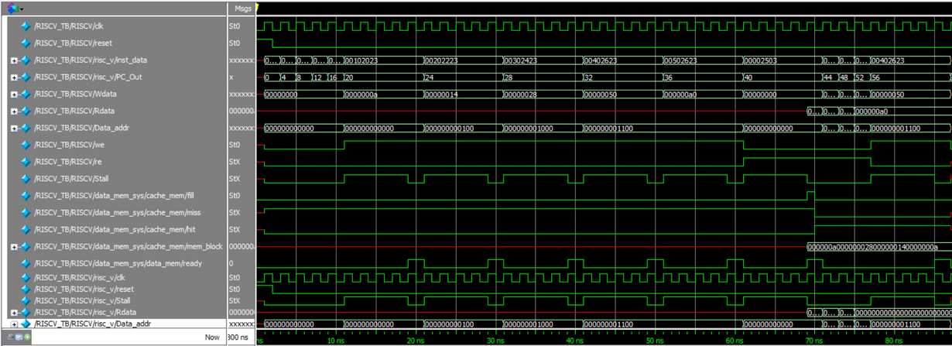
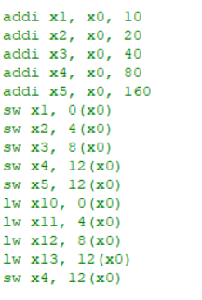
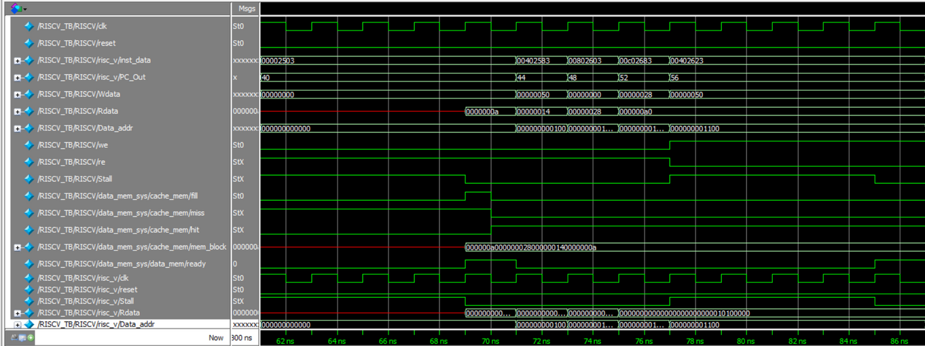
Program 2

Slide 17
Any Questions?

Slide 18
Thank You

